Slide 1

Financial Analysis of Reliance Industries Limited
Presenter: Pranav Nandeshwar

Slide 2

Content
1. Stock Performance Overview
2. Models for Stock Prediction
3. Conclusion and Implications

Slide 3

Section 1
Stock Performance Overview

Slide 4


Exploring Numerical Features
Feature Distribution
Data Visualization
Long-Term Trends
Open: The price of the stock at the beginning of the trading day.
High: The highest price of the stock during the trading day.
Low: The lowest price of the stock during the trading day.
Volume: The number of shares traded during the trading day.
Close: The price of the stock at the end of the trading day (target variable).
Utilizing histograms, line chart and bar charts.
The line chart from 2014 to 2024 depicts, ranging from approx. 400 to more than 3000 INR. This provides a comprehensive view of the stock's performance over a decade.
The closing prices over time reveal the long-term trends in the stock's performance, offering insights into its stability and growth potential.

Slide 5

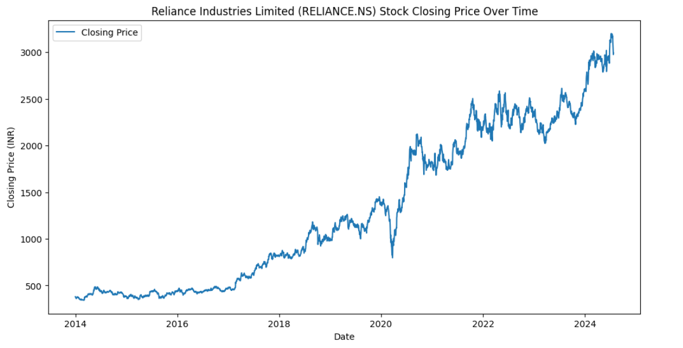
Trend

Slide 6
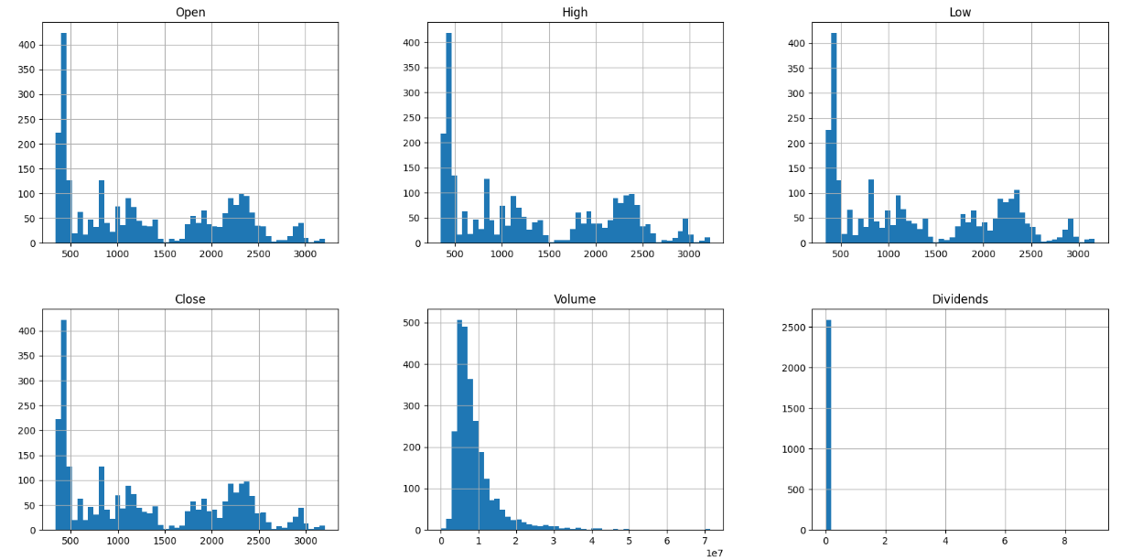
Histogram Plots

Slide 7

Section 2
Models for Stock Prediction

Slide 8

Model Building
Algorithms Used:
Linear Regression
Random Forest
Ridge Regression
Lasso Regression
Training and Testing
Data split and model training process

Slide 9
Model Evaluation Metrics
RMSE (Root Mean Squared Error)
Measure of prediction accuracy.
Values of 17.5 for training and 17.85 for testing
R² (Coefficient of Determination)
Measure of model fit.
Showcasing the degree of fit between the predicted and actual stock prices.

Slide 10
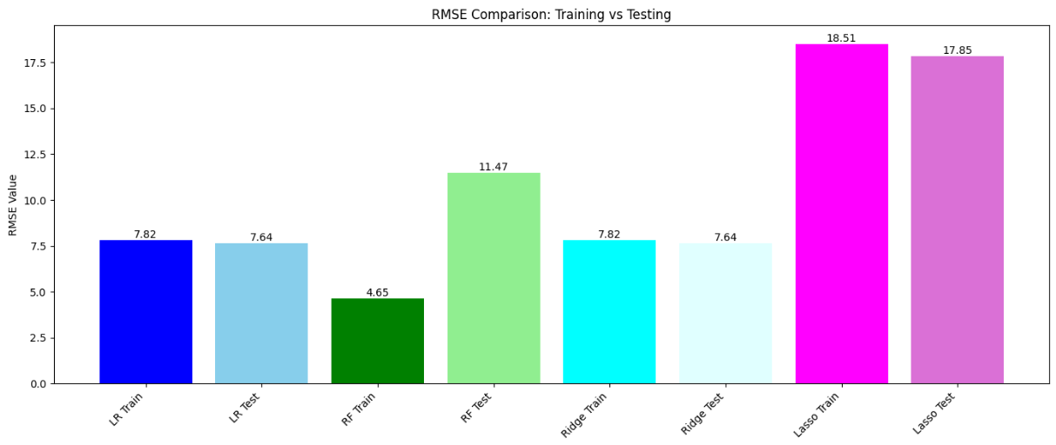
RMSE Comparison

Slide 11
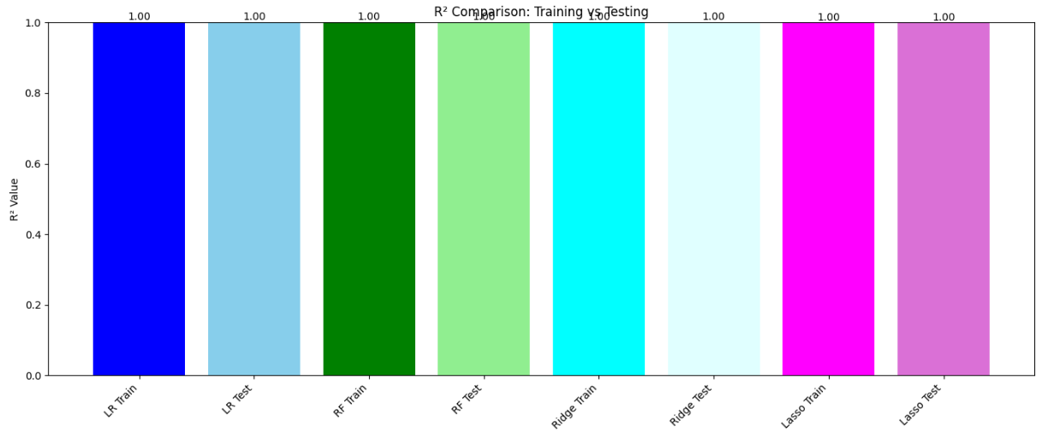
R² Value Comparison

Slide 12
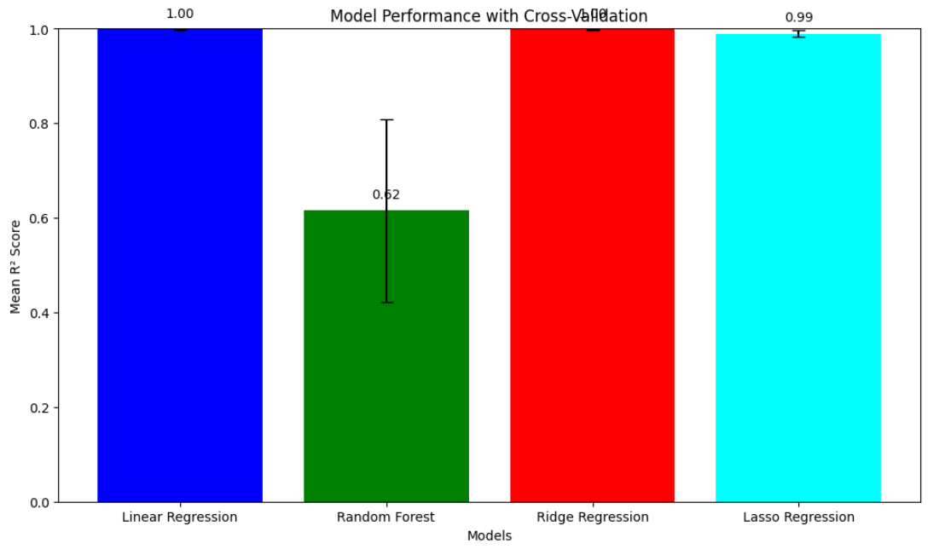
Cross-Validation
Purpose: Ensuring model robustness.
Results: Cross-validation scores for each model.

Slide 13

Model Performance with Cross-Validation
01
02
Mean R-Squared Score
Model Comparison
The mean R-squared score and model performance with cross-validation has been discussed, comparing four models: Linear Regression, Random Forest, Ridge Regression, and Lasso Regression. The mean R-squared score of 1.00 indicates excellent model performance, demonstrating the effectiveness of the statistical models in predicting stock prices.
The comparison of different statistical models provides insights into their individual strengths and weaknesses, offering valuable information for informed decision-making in stock investment.

Slide 14
Section 3
Predictive Analysis and Conclusion

Slide 15
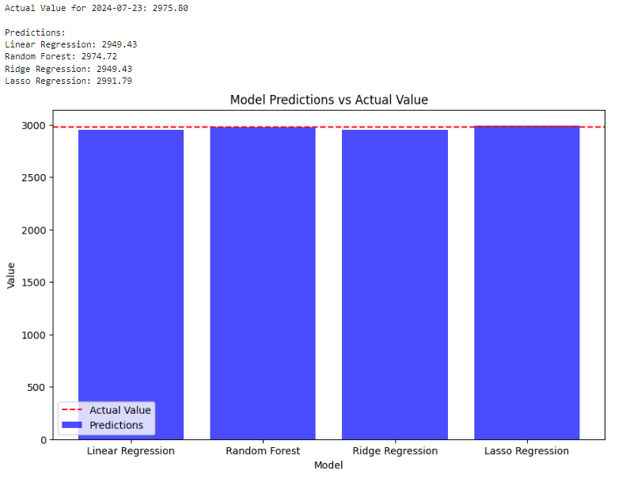
Prediction on Data

Slide 16


Conclusion
Real-World Applications
Future Considerations
Investment Strategy Development
Portfolio Management
Market Analysis
Financial Forecasting
Enhancing Model Accuracy
Real-Time Predictions
Cross-Market Analysis
User-Friendly Interfaces and Tools

Slide 17

Thank You
Contact: pranav.nandeshwar@outlook.com

